Slide 2
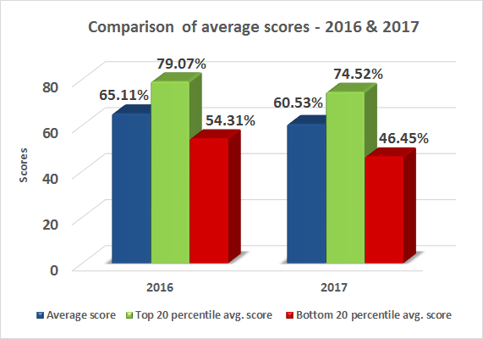

Slide 3
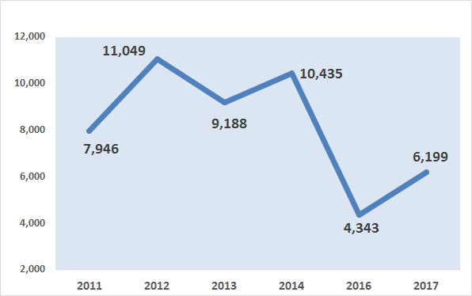
NO. OF QUESTIONS ASKED PERTAINING TO THE PERIOD IN PRAJA’S REPORT CARDS OF THE CORRESPONDING YEARS
In each year three sessions were taken, while in 2014 four sessions were taken

Slide 4
Note: 1) Scores for the corresponding year (2012) in the last term have been given for comparison with the current year (2017).
2) This year, we have changed the methodology for assigning weightages for questions. We have combined the weightages given for the importance of the issue with its classification under the seventh schedule of the constitution.

Slide 5
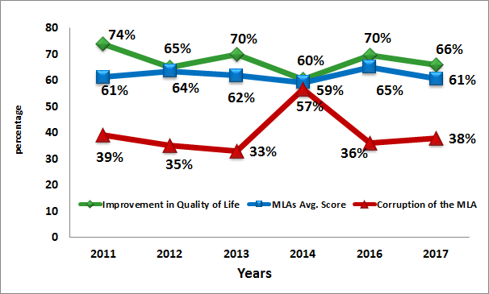
PERCEIVED CORRUPTION & ITS IMPACT ON QUALITY OF LIFE
In 2015, because it was the first year of the MLAs new term, they were not ranked

Slide 6
The Constitution as a Basis for monitoring of Elected Representatives
ERs derive their powers for functioning through the Constitution
They are mandated to Attend Sessions, Raise people’s Issues, Debate, Participate in Discussions and Pass legislations.
The Constitution defines their powers and rules of functioning, hence only the Constitution can provide the parameters for their monitoring.

Slide 8
Parameters for Rating MLAs (1/4)
Parameter | Marks
Present¹(Attendance, No. & Quality of Questions, Usage of Area Development Fund) | 52
Past ²(Education qualification, PAN Card, Criminal cases) | 8
Perception (through an citizen survey of 20,317 people for their perception on their MLA’s accessibility/availability, performance, corruption, and satisfaction with quality of life, services provided by government) | 40
Negative for new FIR cases after 2014 election ³ | Minus 5
Negative for pending Charge Sheet ³ | Minus 5
Total | 100
RTI Data Source: ¹ Vidhan Bhavan and City & Suburban Collector Offices; ² Election Commission of India’s Website; ³ Mumbai Police.

Slide 9
Parameters for Rating MLAs (2/4)
Present Parameter (Marks)
Sessions Attended Based on percentage of attendance. 1) 100% to 91%- 10; 2) 90% to 76% - 8; 3) 75% to 61% -6; 4) 60% to 51% - 4; and 5) below 50% - 0 | 10
Number of Questions Asked Against Group Percentage Rank. 16 being the top most percentile and so on to the lowest for 1 | 16
Importance of questions asked Issues are given certain weightages depending on the importance of the issue as per the seventh schedule of the Constitution of India. Further weighted by the score for number of questions asked. | 21
Total Local Area Development Funds Utilised during April 2016 to March'2017 Calculation for the current financial year is done for the sanctioned fund of Rs. 2 crore.1) 100% (or more) to 91%- 5; 2) 90% to 76% - 4; 3) 75% to 61% -3; 4) 60% to 51% - 2; and 5) below 50% - 0 | 5

Slide 10
Parameters for Rating MLAs (3/4)
Past Parameter (Marks)
Education Qualification A minimum of 10th Pass - 1; if not – 0 | 1
Income Tax !) Possessing PAN Card - 1 2) Filling of last years IT returns – 1 | 2
Criminal Record If the candidate has zero cases registered against her/him, then 5; else as below: 1) Criminal Cases Registered containing the following charges: Murder, Rape, Molestation, Riot, Extortion - 0 2) Other criminal cases than the above mentioned – 3 | 5

Slide 11
Parameters for Rating MLAs (4/4)
Perception Parameter (Marks)
Perception of Public Services Score on Public Services | 20
Awareness & Accessibility Score on Awareness amongst people about their representative, their political party and ease of access to the representative | 6
Corruption Index Score on perceived personal corruption of the representative | 10
Broad Measures Score on overall satisfaction and improvement in quality of life | 4
Notes:
!) The weightage for Perception of Public Services was further divided into a hierarchy of 4 levels to meet the desired objective. Level 1 included facilities which are more critical to state government whereas Level 4 included facilities that are more critical to central government.
Level 1 – This level included areas like Power supply, Law & Order situation & Instances of crime. It was given a weightage of 8 points
Level 2 – This level included areas like Availability of food through ration shops & Pollution problems. It was given a weightage of 5 points
Level 3 – This level included areas like Hospitals & other Medical facilities & Appropriate Schools & Colleges. It was given a weightage of 4 points
Level 4 – This level included rest of the areas like Condition of Roads, Traffic Jams & Congestion, Availability of public gardens, Availability of public transport facilities, Water Supply, Water logging problems & Cleanliness & Sanitation facilities. It was given a weightage of 3 points
2) Broad Overall Measures: included opinions on Satisfaction with the MLA and Improvement in Lifestyle.

Slide 12
Party | MLAs Name | 2016 |  | 2017
 |  | Score | Rank | Score | Rank
INC | Amin Amir Ali Patel | 84.33 | 1 | 78.25 | 1
INC | Kalidas Nilkanth Kolambkar | 72.54 | 7 | 74.93 | 2
INC | Aslam Ramazan Ali Shaikh | 75.76 | 5 | 74.12 | 3
INC | Md. Arif (Naseem) Lalan Khan | 72.13 | 8 | 73.87 | 4
SS | Sunil Waman Prabhu | 80.97 | 2 | 73.17 | 5
BJP | Atul Bhatkhalkar | 67.98 | 11 | 72.79 | 6
INC | Varsha Eknath Gaikwad | 79.40 | 3 | 72.28 | 7
BJP | Yogesh Sagar | 78.35 | 4 | 70.20 | 8
SS | Sunil Govind Shinde | 75.63 | 6 | 69.26 | 9
BJP | Ashish Babaji Shelar | 67.40 | 12 | 68.56 | 10
BJP | Manisha Ashok Chaudhary | 65.71 | 16 | 68.32 | 11
BJP | Sardar Tara Singh | 68.81 | 9 | 65.84 | 12
BJP | Ameet Bhaskar Satam | 59.27 | 21 | 62.52 | 13
BJP | Raj Purohit | 58.60 | 22 | 60.79 | 14
SS | Sunil Rajaram Raut | 57.77 | 24 | 59.81 | 15
SS | Ajay Vinayak Choudhari | 68.80 | 10 | 59.15 | 16
SP | Abu Asim Azmi | 63.04 | 17 | 58.46 | 17
BJP | Mangal Prabhat Lodha | 67.13 | 13 | 58.20 | 18
SS | Trupti Prakash Sawant |  |  | 57.84 | 19
BJP | Parag Madhusudan Alavani | 54.51 | 28 | 57.54 | 20
SS | Prakash Vaikunt Phaterpekar | 65.88 | 15 | 56.94 | 21
SS | Mangesh Anant Kudalkar | 53.96 | 30 | 55.83 | 22
BJP | Bharati Hemant Lavekar | 60.14 | 19 | 53.91 | 23
SS | Prakash Rajaram Surve | 56.25 | 27 | 52.63 | 24
SS | Sanjay Govind Potnis | 58.37 | 23 | 51.65 | 25
SS | Sadanand Shankar Sarvankar | 66.38 | 14 | 51.41 | 26
AIMIM | Waris Yusuf Pathan | 57.71 | 25 | 51.24 | 27
SS | Ramesh Kondiram Latke | 54.39 | 29 | 48.11 | 28
SS | Ashok Dharmaraj Patil | 60.85 | 18 | 46.50 | 29
BJP | Selvan R. Tamil | 57.21 | 26 | 46.18 | 30
SS | Tukaram Ramkrishna Kate | 59.70 | 20 | 44.70 | 31
BJP | Ramchandra Shivaji Kadam | 49.55 | 31 | 41.96 | 32

Slide 13
MLAs with criminal cases as per Representative of People’s Act 1951
50% MLAs have criminal cases.
18 MLAs out of 36 have criminal cases (FIRs) registered against them and of the 18 MLAs, 12 have charge sheets filed against.
Note: This data includes all four designated ministers along with 32 MLAs.
Notes:
Ideology and No Social Service

Slide 15
Note: This year, we have changed the methodology for assigning weightages for questions. We have combined the weightages given for the importance of the issue with its classification under the seventh schedule of the constitution.

Slide 17
Note: (*) While we evaluated the performance of 12 Shiv Sena MLAs in 2016, but this year we have evaluated the performance of 13 Shiv Sena MLAs, because one MLA was newly elected in April 2015.

Slide 18
Note: Scores for the corresponding year (2012) in the last term have been given for comparison with the current year (2017).

Slide 19
THANK YOU!!!

